Slide 1
Lesson 1

Slide 2
Welcome!
Sequence analysis (SAn), or how to go from events to trajectories

Slide 3
Who am I?
Joan Damiens, PhD in demography in 2023
Researcher at the Helsinki Institute for Demography and Population Health
Research on health inequalities, housing, family background, life-course trajectories

Slide 4
Who are you?
What is your discipline?
What trajectory are you interested in?
What kind of longitudinal data do you have?
R level: beginner/intermediate/advanced?

Slide 5
What the course will cover
build → describe → compare → cluster → interpret
Lesson 1: build and describe
Lesson 2: distances and OM
Lesson 3: clustering and typologies
Lesson 4: interpretation, mini-projects, presentations

Slide 6
Main references used to build that course

Slide 7
Your main task
A mini-project:
Short written report (~5 pages)
5-minute presentation in final session in 4 slides
Focus more on the methodological choices, not only on the result or commands

Slide 8
The report
Modalities
Sections
Around 5 pages and 2,000-2,500 words
A R Markdown (.rmd) template is provided; feel free to use any other format.
Deadline: to be determined
Title
Research question
Data and sequence construction
Analytical strategy
Sequence description
Dissimilarity measure
Clustering
Further analysis
Results
Interpretation
References

Slide 9
What to put in the presentation
Powerpoint or any other format
No template provided
Slide 1: Question and data
RQ
Population
sequence period
Slide 2: How you constructed the sequences
States
Time axis/unit
One important methodological choice
Slide 3: Main figure
For example: cluster state-distribution plots; index plots; or predicted outcome by trajectory.
Explain what the audience should see.
Slide 4: What we learned
Main finding
One limitation
One next step or sensitivity analysis

Slide 10
How you will be evaluated
Criterion | Weight
Research question and sequence design | 20%
Methodological choices and justification | 30%
Analysis and figures | 20%
Interpretation, sensitivity and limitations | 20%
Presentation and clarity | 10%
PASS/FAIL

Slide 11
Today’s task
Explain when SAn is useful
1
Define states, transitions, spells, alphabet
2
Choose a time axis and time unit
3
Create a sequence object in R
4
Read index and state distribution plots
5

Slide 12
Programme of the labs
R + RStudio installed
Packages: TraMineR, tidyverse
To download on Moodle or GitHub: lab scripts and lab sheets
Work in pairs if needed
Lesson 1: build sequences
Lesson 2: distances
Lesson 3: clusters
Lesson 4: interpretation
Notes:
Each lab produces one part of your final report.

Slide 13
Why Sequence Analysis (SAn)?

Slide 14
What is the life-course (LC) paradigm?
Elder (1994)
Lives unfold over time and within a context
Trajectories and transitions
Lives consist of long-term trajectories punctuated by transitions.
E.g., educational, employment, partnership and parenthood trajectories…
Timing
The consequences of an event may depend on when it occurs.
E.g. unemployment at 20 vs. 55 → different consequences
Linked lives
Individual lives develop in relation to the lives of others
E.g. parents, children, partner, siblings…
Historical and institutional context
The same transition may have different meanings in different cohorts, countries or policy contexts
E.g. entering the labour market during a recession…
To understand where someone is today, we may need to understand the pathway that brought them there.

Slide 15
Sequence analysis: a first puzzle
Employed at 35
Stable employment since age 20
Care and family interruption
Unemployment
Repeated unstable jobs
Notes:
Are these people the same in a regression measured only at age 35?
If our dataset contains only employment status at age 35, what disappears?

Slide 16
Sequence analysis: a first puzzle
Employed at 35
If our dataset contains only employment status at age 35, what disappears?
timing of labour-market entry;
accumulated unemployment;
instability;
care-related interruption;
pathways back into employment.
Notes:
Are these people the same in a regression measured only at age 35?
If our dataset contains only employment status at age 35, what disappears?

Slide 17
Reason to use SAn #1 It brings personal history into the analysis
We observe how states develop over time.
We retain information about timing, duration and interruptions.
Past experiences can be related to later outcomes.

Slide 18
Example 1: school to work transitions
To complete with https://academic.oup.com/esr/article-abstract/23/4/409/479592

Slide 19
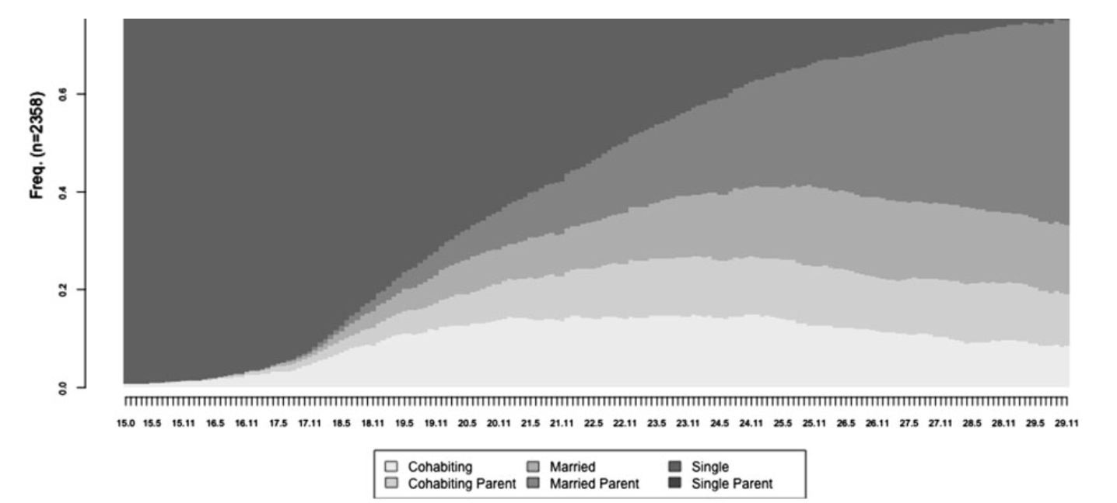
Example 2: family formation trajectories
Fig.2 Distribution of family states, women aged 15-30, weighted frequencies. From Barban (2013)

Slide 20
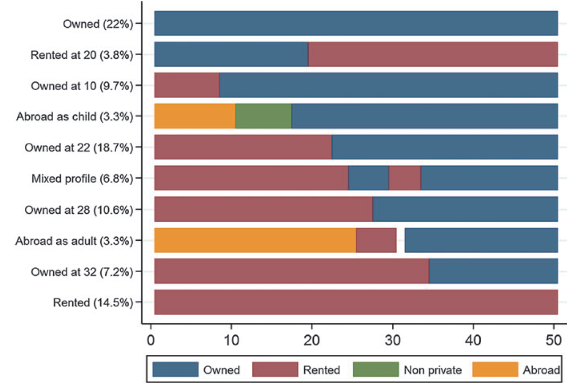
Example 3: transition to adulthood? Health? work-family trajectories?
Fig.2 Modal plot of the ten housing careers (proportion of respondents) (N = 7505). From Vanhoutte et al. (2017)
Notes:
Use Vanhoutte et al.’s housing modal plot: owned, rented, non-private, abroad. Message: studying only “first homeownership” misses people who never own, lose ownership, or move between housing states.

Slide 21
Reason to use SAn #2 Events are moments; trajectories contain a before and an after
Event-based methods
Focuses on a particular transitions (e.g., first residence, first, second or third child, etc.)
well suited to event-history analysis;
people who do not make the transition remain non-event or censored cases;
what happens after the transition may not be central.
Holistic methods
Focuses on experiences between ages (e.g., housing and family trajectories between ages 20 and 50)
includes people who never go through the event;
captures reversals and repeated transitions;
compares complete patterns;
preserves differences in timing and duration.

Slide 22
What life-course research cares about
Timing: when?
Order: what before what?
Duration: how long?
Instability or quantum: how many changes?

Slide 23
Reason to use SAn #3 Time can influence outcomes in different ways
Life-course mechanism | Sequence feature | Question
Accumulation | Total duration | How long?
Critical or sensitive period | Timing | When?
Mobility or direction | Order of states | In which direction?
Chain of risk | Ordered succession | What follows what?
Instability | Repeated transitions and short spells | How fragmented?

Slide 24
Different types of sequences
Employed
Unemployed
A
B
C
D
STABLE
UNSTABLE?
DOWNWARD?
UPWARD?
Duration alone cannot capture timing, order and fragmentation.
Notes:
Who has the most unemployment? (A=B=C)
Who experiences disadvantage earliest? (B)
Who follows an upward trajectory? (B)
Who follows a downward trajectory? (A)
Who has the greatest instability? (C)
Would a variable counting “years unemployed” distinguish A, B and C?

Slide 25
What these figures reveal that a regression table does not
Heterogeneity
Timing
Pathways
Notes:
Sequence analysis does not, by itself, “test” these mechanisms causally. It helps you:
represent them;
construct relevant measures;
identify patterns consistent with them;
compare their association with outcomes.
Formal testing requires an appropriate subsequent design or model.

Slide 26
What is Sequence Analysis? (SA)
A history anchored in biology
From biological sequences…
DNA: G T A C A T G…
To social sequences
Partnership: Unmarried, married, divorced, re-married…
Sequence analysis: Methods to visualise, describe, compare and group ordered sequences.
1995: Andrew Abbott, Sequence Analysis: New Methods for Old Ideas
2000s onward: expansion of life-course applications, distance measures, clustering and software
Today: applications across sociology, demography, public health and other social sciences

Slide 27
From life-course data to sequences

Slide 28

What is a trajectory?
From lived lives to coded sequences
A trajectory is the unfolding process.
A sequence is the coded representation of that trajectory.
Sequence analysis studies the coded representation, not life itself.

Slide 29
What are sequential data
Sequential data: repeated observations whose order is preserved
Employed
Unemployed
A
B
C
Notes:
All three have:
four periods employed;
four periods unemployed.
But they differ in:
timing;
duration of spells;
number of transitions;
order;
direction.

Slide 30
What are sequential data
Sequential data: repeated observations whose order is preserved
Units
Individuals, households, organisations, countries, etc.
A timeline
Age, calendar year, month, survey wave or time since an event.
A finite set of possible states
The sequence alphabet.
An observed state at each time position
One categorical status, or a defined combination of statuses.
Notes:
All three have:
four periods employed;
four periods unemployed.
But they differ in:
timing;
duration of spells;
number of transitions;
order;
direction.

Slide 31
1990: birth
2011: first job
2019: gets married
2021: first child
2023: gets divorced
Trajectory
Sequence
Unmarried
Married
Divorced

Slide 32
States, transitions and spells
A sequence is:
A state is :
A spell is :
A transition is : →
U | U | U | U | U | U | U | U | M | M | M | M | D | D
U
M
D
U | U | U | U | U | U | U
U
M

Slide 33
Sequence alphabet
The theoretical definition of the categories
Simple
Education / Employment / Unemployment / Inactivity
More elaborate:
School / Training / Full-time work / Part-time work / Unemployment / Care work / Other

Slide 34
Where to find appropriate data
Prospective panel surveys
The same people are interviewed repeatedly.
Information collected for research and rich covariates
Often attrition, gaps between waves and relatively short observation windows.
Retrospective life-history surveys (SHARE, ELSA, HRS…)
Respondents reconstruct past experiences, often using a life-history calendar.
Long portions of the life course, on several domains
But possible recall error and imprecisions
Administrative and register data
Records generated by institutions are linked over time.
Large populations, with low non-response rates and long follow-up, with relatively precise dates.
Challenges: access and data protection; changing administrative definitions; only events recorded by institutions; data were not created for the research question.
Notes:
The data source determines which parts of life are visible—and at what resolution.

Slide 35
The choice of a time axis
We can align trajectories by
Age (in years, in months…)
Calendar time (years, months)
Time since events
18 | 19 | 20 | 21 | 22 | 23 | 24
Jan 2000 | Feb | Mar | Apr | May | Jun | Jul | Aug | Sep | Oct | Nov | Dec | Jan 2001 | Feb
Childbirth year | Year +1 | Year +2 | Year +3 | Year +4 | Year +5 | Year +6

Slide 36
The choice of a time axis
This choice depends on the research question and can change the approach.
We can align trajectories by
Age (in years, in months…)
Calendar time (years, months)
Time since events
18 | 19 | 20 | 21 | 22 | 23 | 24
Jan 2000 | Feb | Mar | Apr | May | Jun | Jul | Aug | Sep | Oct | Nov | Dec | Jan 2001 | Feb
Childbirth year | Year +1 | Year +2 | Year +3 | Year +4 | Year +5 | Year +6

Slide 37
The choice of a time axis
A has one baby at age 22
B has one baby at age 35
ALIGNED by AGE
20
LEAVE
25
30
35
20
FULL TIME
A
B
PART-TIME
Notes:
At age 22:
* A is on parental leave.
* B is in full-time employment.
At age 30:
* A has already returned to stable employment.
* B is beginning parental leave.
The sequences will appear quite different because age at first birth is part of the trajectory.
Research question: How do women’s employment and family trajectories unfold between ages 20 and 35?
Or more specifically: What types of work–family trajectories characterise young adulthood, and how do they differ in the timing of parenthood?
Here, the analysis captures:
* early versus late parenthood;
* employment before and after parenthood;
* childlessness during the observation window;
* differences in the order and timing of work and family transitions.
Age alignment is therefore appropriate when the timing of childbirth within the life course is substantively important.

Slide 38
The choice of a time axis
A has one baby at age 22
B has one baby at age 35
ALIGNED by AGE
20
LEAVE
25
30
35
20
FULL TIME
A
B
PART-TIME
ALIGNED by EVENT
t0
20
A
33
B
Notes:
The two trajectories now appear almost identical. Their ages are different at each position.
The comparison is no longer between people at the same age. It is between people at the same distance from childbirth.
Research question: How do women’s employment trajectories evolve before and after first birth?
Or: What patterns of employment interruption and return to work occur around the transition to parenthood?
Here, the analysis focuses on:
* anticipation before childbirth;
* interruption at childbirth;
* speed and form of return to work;
* stability or instability following childbirth.
Age at first birth is no longer directly represented by the position of the states. It would need to be added separately as:
- a covariate;
- a stratifying variable;
- or part of a comparison between early and late mothers.

Slide 39
What changes?
The meaning of time
The source of ”similarity” between observed trajectories
The population
The variation of interest
Age alignment treats age at first birth as part of the sequence variation.
Event alignment removes that variation from the time axis so that the analysis can concentrate on what happens around birth.
The interpretation
Ideally, the research question determines alignment, but alignment also changes the research question in practice

Slide 40
A third alternative
20
LEAVE
25
30
35
20
FULL TIME
A
B
PART-TIME
ALIGNED by CALENDAR YEAR
Alignment defines what is held constant.
Age alignment holds age constant.
Event alignment holds distance from the event constant.
Calendar alignment holds historical time constant.
A
B
2011
2020
2015
Notes:
Suppose the sequences cover 2008–2020 for everyone.
This could answer: How did employment trajectories develop during a common historical period?
Or: How did trajectories change around the introduction of a parental-leave reform in 2015?
People would be at different ages in the same calendar year. This alignment highlights period and institutional context rather than age or time since birth.

Slide 41
What time unit? Year or month?
Can hide instability, ignores changes within the years
2015 | 2016
Easier to interpret
Captures shorter spells, more precise
J 2015 | F | M | A | M | J | J | A | S | O | N | D | J 2016 | F | M | A | M | J | J | A | S | O | N | D
Requires very precise data, can create noise and misreport

Slide 42
Missingness, censoring, incomplete histories
Complete sequence
Missing gap
In the middle
Censored sequence
Missing is not a state or substantive information… Unless you decide otherwise

Slide 43
Wide, long and spell data formats
From wide to long format
WIDE
id | age20 | age21 | age22 | age23 | age24
101 | E | E | U | E | E
Convenient for cleaning, merging and constructing states.
LONG
id | age | state
101 | 20 | E
101 | 21 | E
101 | 22 | U
101 | 23 | E
101 | 24 | E

Slide 44
Spell format
LONG
id | age | state
101 | 20 | E
101 | 21 | E
101 | 22 | U
101 | 23 | E
101 | 24 | E
Compact when data contain exact start and end dates.
SPELL
id | state | start age | end age | duration
101 | E | 20 | 21 | 2
101 | U | 22 | 22 | 1
101 | E | 23 | 24 | 2

Slide 45
Format summary table
Format | One row represents | Main advantage | Main difficulty for SAn
Wide | One person | Sequence is directly visible | Many columns; not convenient for cleaning
Long | One person at one time point | Flexible for data management | Must generally be reshaped before defining sequences
Spell | One continuous episode | Compact; preserves start/end date information | Must be converted to a common time grid
Notes:
We have to emphasise that the three formats do not represent three different histories. They are three ways of storing the same information.
Also we must explain:
* Long data may contain repeated observations for every month or year.
* Spell data only record when a state begins and ends.
* To compare sequences, observations generally need to be placed on a common timeline.
* The conversion may require substantive decisions about overlaps, gaps and simultaneous statuses.

Slide 46
What sequence analysis can and cannot do

Slide 47
What Sequence Analysis (SAn) can do
Describe trajectories
Build typologies
Construct exposures for later analysis
Important: Not every sequence analysis needs clustering.

Slide 48
What SAn cannot do
SAn is not automatically causal
Clusters are not natural groups
Nice plots do not replace theory
Interpretation depends on state definitions

Slide 49

More than just pretty plots
plot

Slide 50
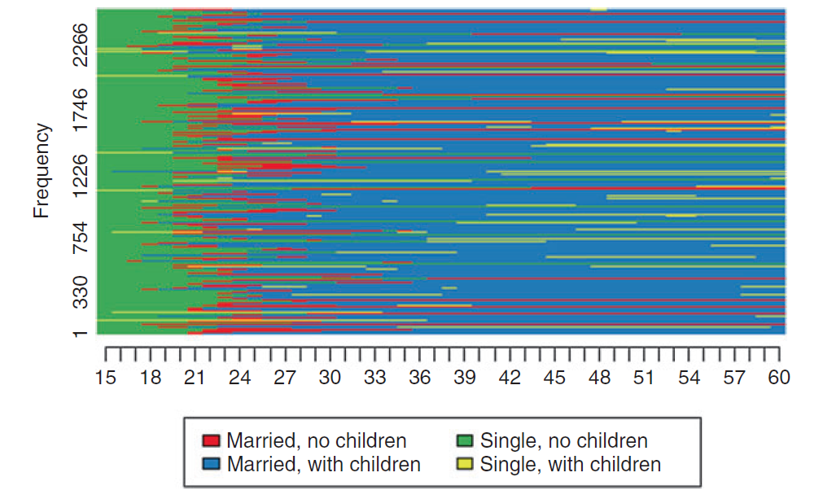
More than just pretty plots (1) Index plots
Fig.3 Index plot of women’s family history (N = 2547). From Vanhoutte et al. (2018)
Shows individual pathways → one line per individual sequence
How individuals move between states over time

Slide 51
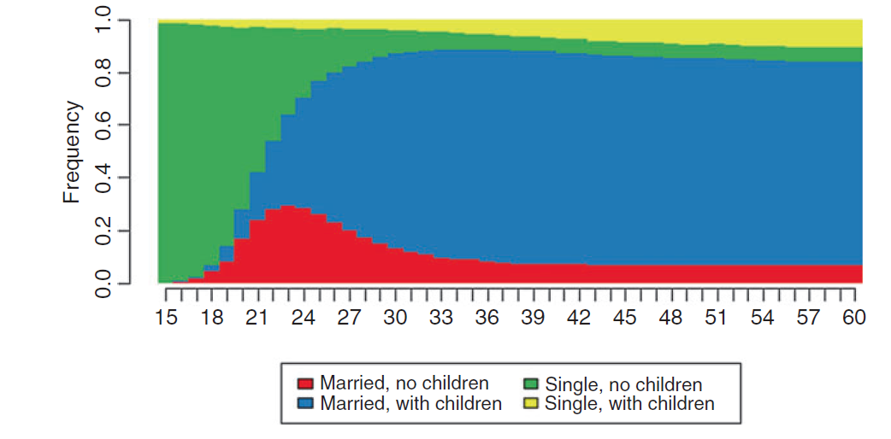
More than just pretty plots (2) State distribution plots or chronogram
Fig.4 Density plot of women’s family history (N = 2547)).From Vanhoutte et al. (2018)
Proportion of observations in each state for each time point.
Describes the change in the composition of a group or a sample over time.

Slide 52
SAn choices are research choices
Population
Period
Time axis
Time unit
States
Missingness
Plots

Slide 53
Preview of next lesson
Today: build and describe
Next: distance between sequences
Then: clustering
Final: interpretation and student projects

Slide 54
References

Slide 55
Exercise time

Slide 56
Dataset introduction
SQC_course_exercises_package
Data:
sequence_course_long.csv: 13,000 rows, one person-age observation per row. This is the MAIN file. You can practise going from long to wide.
sequence_course_person.csv: one row per person with parental education, childhood SEP, baseline health, etc., plus outcomes at age 32.
sequence_course_wide.csv: a ready-made wide version with emp_18-emp_30, fam_18-fam_30, and house_18-house_30. This is a safety net: if you get stuck in lesson 1, you can still participate in next lessons.
codebook.csv: variable definitions and coding.

Slide 57
Dataset introduction (2)
Synthetic dataset for practice
1,000 synthetic individuals
Observed annually from age 18 to 30
Three sequence domains: employment, family, housing
Background variables before age 18
Outcomes at age 32
Designed for teaching, not representative of Finland!!
Notes:
Symthetic = I created it

Slide 58
For your project: research questions (examples)
Track | Sequence | Example research question
A | Employment | How do school-to-work trajectories differ by parental education?
B | Employment | Are employment trajectories associated with later mental health?
C | Employment | Do employment trajectories differ between women and men?
D | Family | How do family-formation trajectories differ by social background?
E | Family | Are different family trajectories associated with later well-being?
F | Housing | How do housing trajectories differ by socioeconomic background?
Notes:
select one of your predefined questions; or propose their own question using the same dataset, subject to a quick check from you.

Slide 59
Two phases
Phase A: guided analysis
Example: employment sequences
We run the code together, we check the outputs and discuss interpretation and meaning of the analysis
Phase B: your turn
You do exactly the sam estep for your own research question
You may change:
Sequence domain
Subgroup comparison
Distance settings
Cluster solution
Later outcome.
What you can do:
Run the guided example first
Ask conceptual questions, not only coding questions
Then adapt the code to your own mini-project
Keep notes in your passport/checklist
Save your script every session
Script + sheet

Slide 60
Mission for today – guided part
Today we will:
Load and inspect the longitudinal dataset
Move between long and wide formats
Define the sequence alphabet
Create a traminer sequence object
Produce an index plot
Produce a state distribution plot
Calculate basic descriptors.

Slide 61
Mission for today – your project
Each student decides:
Research question
Population
Sequence domain
Time axis
Time unit
State alphabet.
Then produces:
One descriptive sequence plot
2-3 sentences interpreting it.
From the report:
Research question + Data and sequence construction

Slide 62
Mini project
Your toolkit:
guided R scripts
mini-project report template
mini-project passport/checklist
final report template
Targeted report sections:
Research question and rationale
Data and sequence construction
Before leaving today, write down:
My research question is...
I study ___ trajectories
My population is...
My time axis is...
My time unit is...
My states are...
Sequence analysis is useful here because...

Slide 63
Mini project steps
Step 1: Choose a track
Examples:
Employment trajectories and parental education
Employment trajectories and later mental health
Family trajectories and childhood SEP
Housing trajectories and social background
Step 2 : Create your sequence object
Adapt the guided code to your chosen domain.
Step 3: Produce one descriptive figure
Choose either:
index plot
state distribution plot
grouped state distribution plot
Step 4: Write three interpretation sentences
What is the dominant pattern?
Where is there heterogeneity?
What can you not conclude yet?

Slide 64
Extra slides and clues

Slide 65
From raw data to sequence object
library(TraMineR)
data(mvad)
mvad.scodes <- c("EM", "FE", "HE", "JL", "SC", "TR")
mvad.labels <- c("Employment", "Further education",
"Higher education", "Joblessness",
"School", "Training")
mvad.seq <- seqdef(mvad, 15:86,
states = mvad.scodes,
labels = mvad.labels)

Slide 66
First plot: sequence index plot
seqIplot(mvad.seq, sortv = "from.start")
Try to use:
each row = one person
each column = one month
each colour = one state
sorting affects readability

Slide 67
Second plot: state distribution plot
seqdplot(mvad.seq)
Try to use
each vertical slice = distribution of states at one time point
easier to read aggregate trends
does not show individual pathways

Slide 68
Simple descriptive indicators
time_states <- seqistatd(mvad.seq)
transitions <- seqtransn(mvad.seq)
entropy <- seqient(mvad.seq)
complexity <- seqici(mvad.seq)
Definitions
time in states = exposure
transitions = instability
entropy/complexity = diversity of states and changes

Slide 69
Interpretation exercise
Between month X and month Y, the share of ___ increases/decreases. Individual pathways show ___. This remains descriptive because ___.
Write your own sequence-analysis question in one paragraph: population, period, states, time axis, and expected difficulty.

